Slide 1
Introduction to Hadoop
Unit-IV

Slide 2
INTRODUCING HADOOP
Data: The treasure Trove
Provides business advantages such as
generating product recommendations,
inventing new products,
analyzing the market,
and many, many more, ….

Slide 3
2. Provides few early key indicators that can turn the fortune of business.
3. Provides room for precise analysis. If we have more data for analysis, then we have greater precision of analysis.

Slide 4
Why Hadoop
Its capability to handle massive amounts of data, different categories of data – fairly quickly.

Slide 5
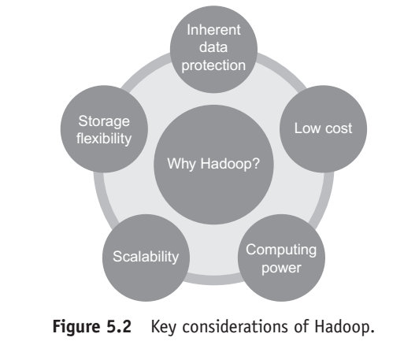

Slide 6
1. Low cost:
Hadoop is an open-source framework and uses commodity hardware (commodity hardware is relatively inexpensive and easy to obtain hardware) to store enormous quantities of data.

Slide 7
2. Computing power:
Hadoop is based on distributed computing model which processes very large volumes of data fairly quickly.
The more the number of computing nodes, the more the processing power at hand.

Slide 8
3. Scalability:
This boils down to simply adding nodes as the system grows and requires much less administration.

Slide 9
4. Storage flexibility:
Unlike the traditional relational databases, in Hadoop data need not be pre-processed before storing it

Slide 10
Hadoop provides the convenience of storing as much data as one needs and also the added flexibility of deciding later as to how to use the stored data.
In Hadoop, one can store unstructured data like images, videos, and free-form text.

Slide 11
5. Inherent data protection:
Hadoop protects data and executing applications against hardware failure

Slide 12
If a node fails, it automatically redirects the jobs that had been assigned to this node to the other functional and available nodes and ensures that distributed computing does not fail. It goes a step further to store multiple copies (replicas) of the data on various nodes across the cluster.

Slide 13
WHY NOT RDBMS?
RDBMS is not suitable for storing and processing large files, images, and videos.
RDBMS is not a good choice when it comes to advanced analytics involving machine learning.
It calls for huge investment as the volume of data shows an upward trend.

Slide 14
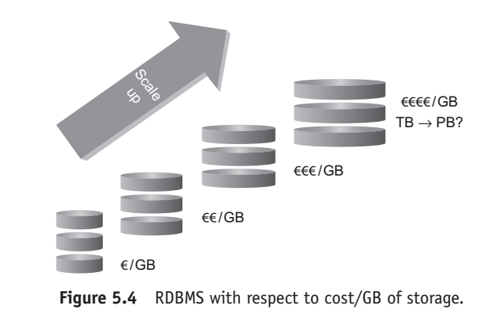

Slide 15
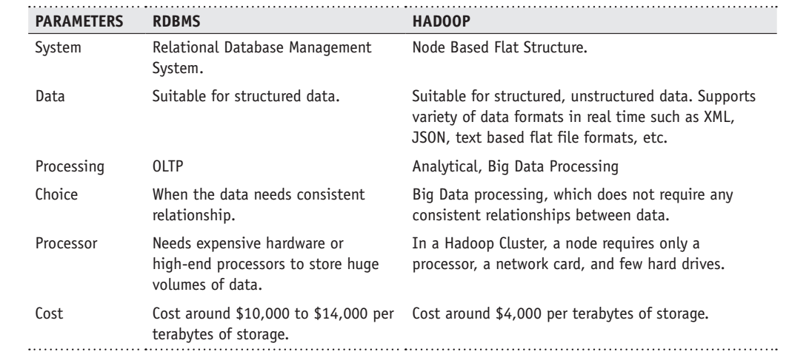
RDBMS versus HADOOP

Slide 16
DISTRIBUTED COMPUTING CHALLENGES
Hardware Failure
In a distributed system, several servers are networked together. This implies that more often than not, there may be a possibility of hardware failure

Slide 17
And when such a failure does happen, how does one retrieve the data that was stored in the system?
Just to explain further – a regular hard disk may fail once in 3 years

Slide 18
And when you have 1000 such hard disks, there is a possibility of at least a few being down every day.

Slide 19
Hadoop has an answer to this problem in Replication Factor (RF).
Replication Factor connotes the number of data copies of a given data item/data block stored across the network. Refer Figure 5.5.

Slide 20
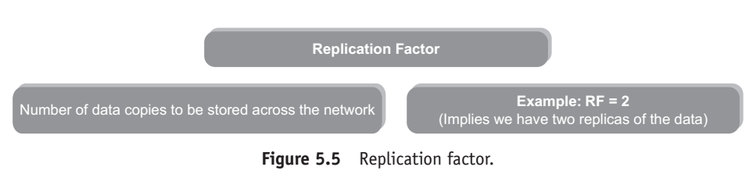

Slide 21
How to Process This Gigantic Store of Data?
In a distributed system, the data is spread across the network on several machines.
A key challenge here is to integrate the data available on several machines prior to processing it.

Slide 22
Hadoop solves this problem by using MapReduce Programming.
It is a programming model to process the data
(MapReduce programming will be discussed a little later).

Slide 23
5.6 HISTORY OF HADOOP
Hadoop was created by Doug Cutting, the creator of Apache Lucene (a commonly used text search library).
Hadoop is a part of the Apache Nutch (Yahoo) project (an open-source web search engine) and also a part of the Lucene project. Refer Figure 5.6 for more details.

Slide 24
5.6.1 The Name “Hadoop”
The name Hadoop is not an acronym; it’s a made-up name.
The project creator, Doug Cutting, explains how the name came about: “The name my kid gave a stuffed yellow elephant.

Slide 25
Short, relatively easy to spell and pronounce, meaningless, and not used elsewhere: those are my naming criteria. Kids are good at generating such. Googol is a kid’s term”.

Slide 26
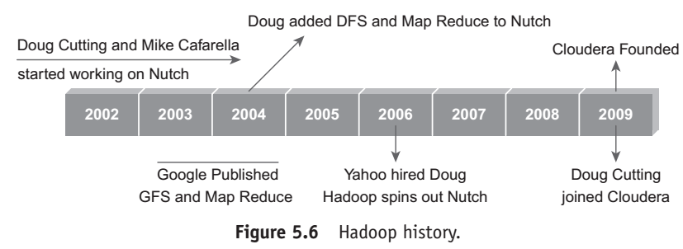

Slide 27
HADOOP OVERVIEW
Open-source software framework to store and process massive amounts of data in a distributed fashion on large clusters of commodity hardware.

Slide 28
Basically, Hadoop accomplishes two tasks:
1. Massive data storage.
2. Faster data processing.

Slide 29
Key aspects of Hadoop

Slide 30
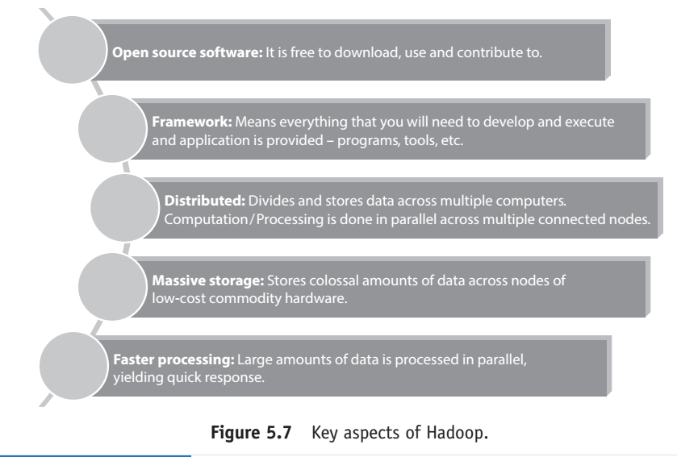

Slide 31
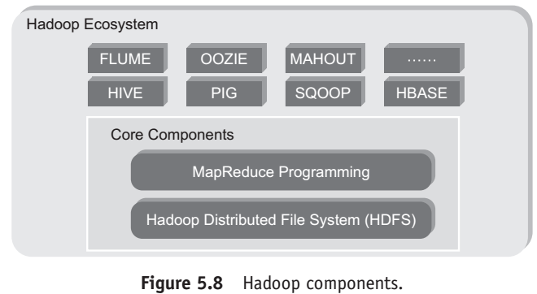
Hadoop Components

Slide 32
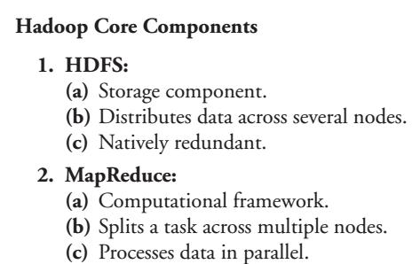

Slide 33
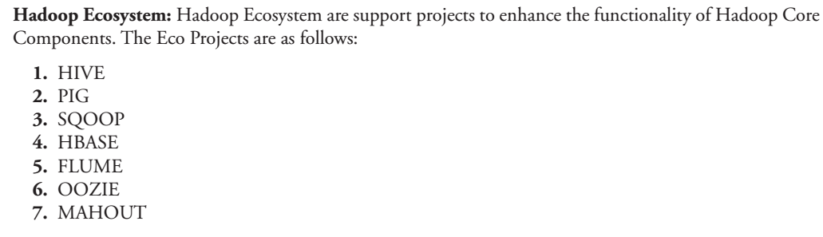

Slide 34
Hadoop Conceptual Layer
It is conceptually divided into
Data Storage Layer which stores huge volumes of data and
Data Processing Layer which processes data in parallel to extract richer and meaningful insights from data (Figure 5.9)

Slide 35
High-Level Architecture of Hadoop
Hadoop is a distributed Master-Slave Architecture.
Master node is known as NameNode and slave nodes are known as DataNodes.
Figure 5.10 depicts the Master–Slave Architecture of Hadoop Framework.

Slide 36
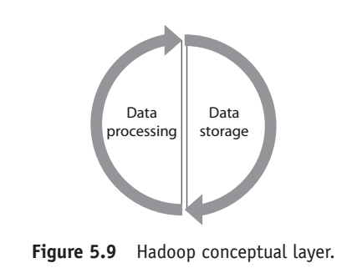

Slide 37
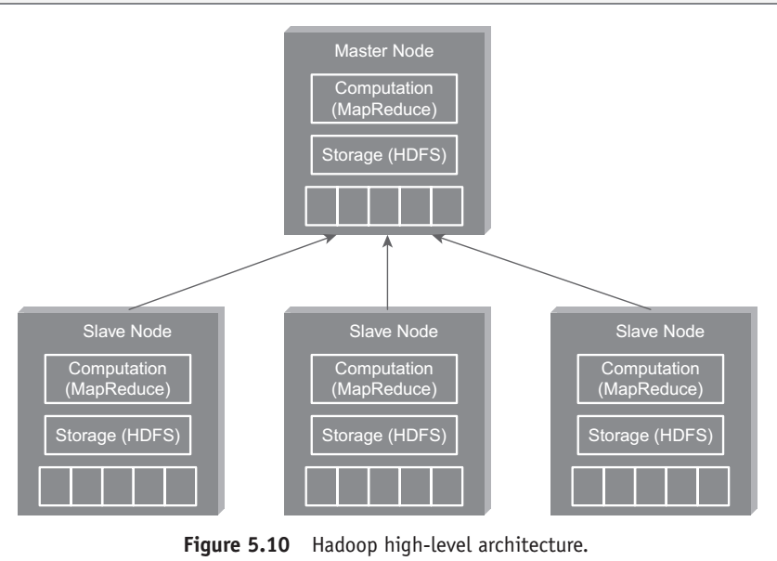

Slide 38
key components of the Master Node.
1. Master HDFS:
2. Master MapReduce

Slide 39
1. Master HDFS: Its main responsibility is partitioning the data storage across the slave nodes.
It also keeps track of locations of data on DataNodes.

Slide 40
2. Master MapReduce: It decides and schedules computation task on slave nodes.

Slide 41
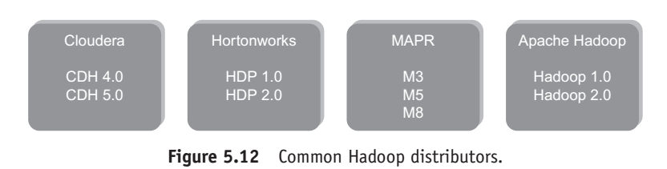
Hadoop Distributors

Slide 42
Hadoop Distributed File System
Some key Points of Hadoop Distributed File System are as follows:
1. Storage component of Hadoop.
2. Distributed File System.
3. Modeled after Google File System.

Slide 43
4. Optimized for high throughput
(HDFS leverages large block size and moves computation where data is stored).
5. You can replicate a file for a configured number of times, which is tolerant in terms of both software and hardware.

Slide 44
6. Re-replicates data blocks automatically on nodes that have failed.
7. You can realize the power of HDFS when you perform read or write on large files (gigabytes and larger).

Slide 45
8. Sits on top of native file system such as ext3 and ext4, which is described in Figure 5.13.

Slide 46
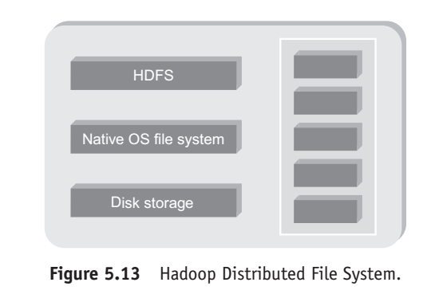

Slide 47
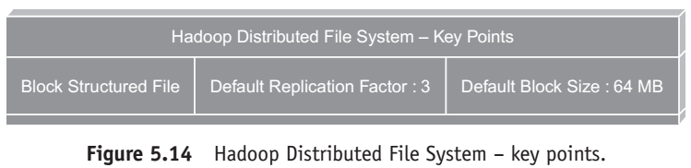

Slide 48
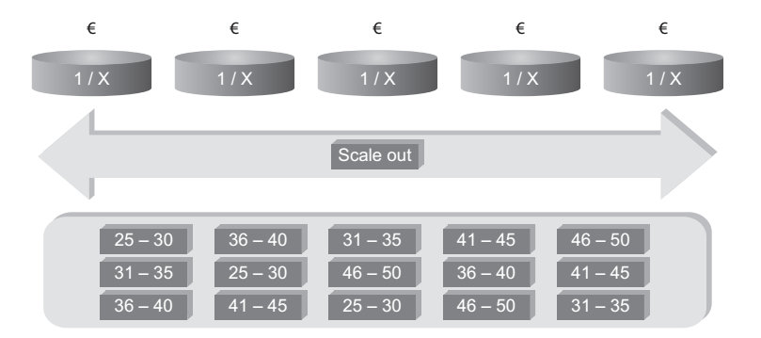

Slide 49
Distributed File System Architecture

Slide 50
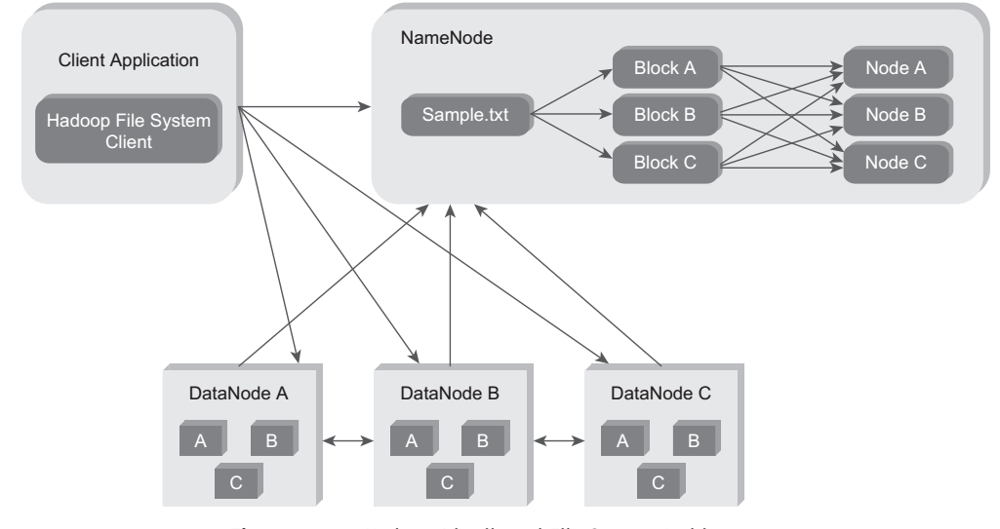
Distributed File System Architecture

Slide 51
HDFS Daemons
1.Name node
2. Data node
3.Secondary Name node

Slide 52
Name node
HDFS breaks a large file into smaller pieces called blocks.
NameNode uses a rack ID to identify DataNodes in the rack.
A rack is a collection of DataNodes within the cluster.
NameNode keeps tracks of blocks of a file as it is placed on various DataNodes.

Slide 53
NameNode manages file-related operations such as read, write, create, and delete.
Its main job is managing the File System Namespace.
A file system namespace is collection of files in the cluster.
NameNode stores HDFS namespace.

Slide 54
File system namespace includes mapping of blocks to file, file properties and is stored in a file called FsImage. NameNode uses an EditLog (transaction log) to record every transaction that happens to the filesystem metadata.

Slide 55
Refer Figure 5.16. When NameNodestarts up, it reads FsImage and EditLog from disk and applies all transactions from the EditLog to in-memory representation of the FsImage.

Slide 56
Then it flushes out new version of FsImage on disk and truncates the old EditLog because the changes are updated in the FsImage. There is a single NameNode per cluster.

Slide 57
DataNode
There are multiple DataNodes per cluster. During Pipeline read and write DataNodes communicate with each other. A DataNode also continuously sends “heartbeat” message to NameNode to ensure the connectivity between the NameNode and DataNode.

Slide 58
In case there is no heartbeat from a DataNode, the NameNode replicates that DataNode within the cluster and keeps on running as if nothing had happened.

Slide 59
Let us explain the concept behind sending the heartbeat report by the DataNodes to the NameNode.

Slide 60
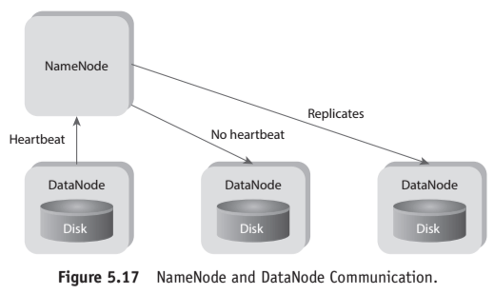

Slide 61
Secondary NameNode
The Secondary NameNode takes a snapshot of HDFS metadata at intervals specified in the Hadoop configuration. Since the memory requirements of Secondary NameNode are the same as NameNode, it is better to run NameNode and Secondary NameNode on different machines.

Slide 62
In case of failure of the NameNode, the Secondary NameNode can be configured manually to bring up the cluster.
However, the Secondary NameNode does not record any real-time changes that happen to the HDFS metadata.

Slide 63
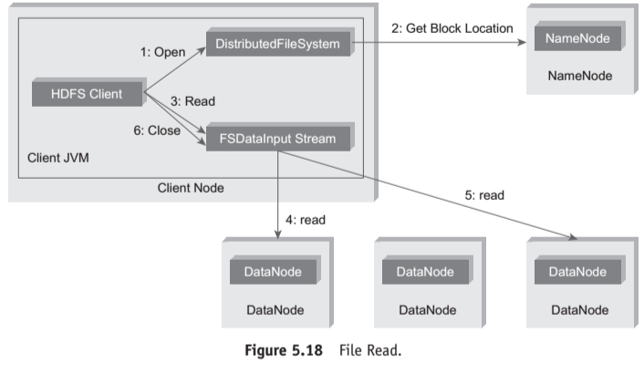
Anatomy of file read

Slide 64
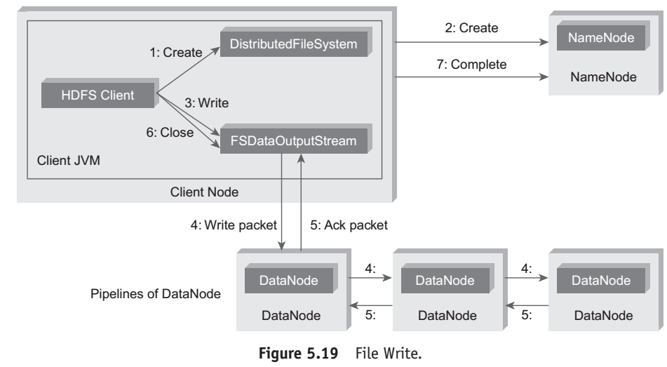
Anatomy of File Write

Slide 65
Replica Placement Strategy
Hadoop Default Replica Placement Strategy
As per the Hadoop Replica Placement Strategy, first replica is placed on the same node as the client. Then it places second replica on a node that is present on different rack

Slide 66
It places the third replica on the same rack as second, but on a different node in the rack. Once replica locations have been set, a pipeline is built. This strategy provides good reliability.

Slide 67
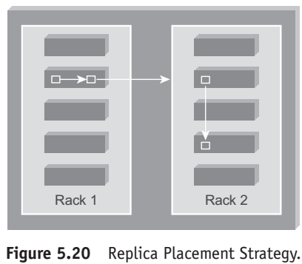

Slide 68
Working with HDFS Commands
Objective: To get the list of directories and files at the root of HDFS.
Act:
hadoop fs -ls/
Objective: To get the list of complete directories and files of HDFS.
Act: hadoop fs -ls -R/

Slide 69
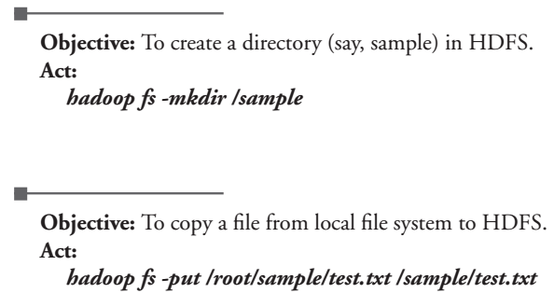

Slide 70
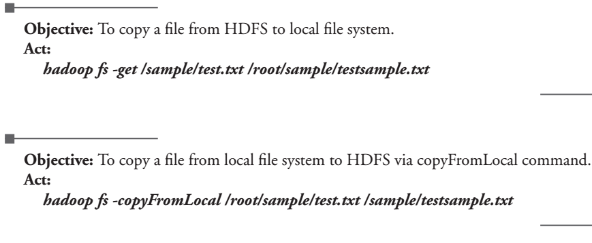

Slide 71
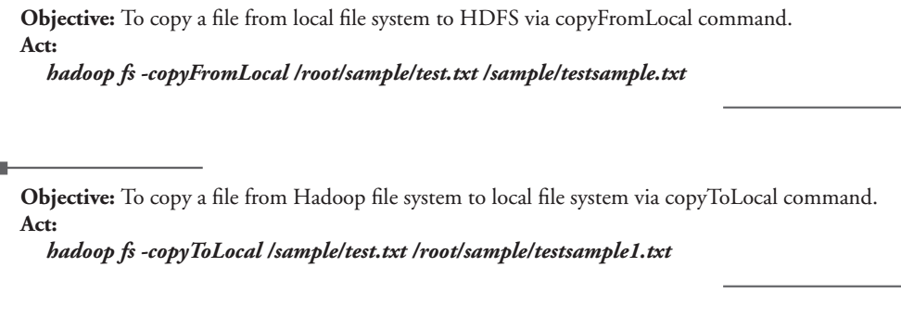

Slide 72
Special Features of HDFS
1.Data Replication
2.Data Pipeline

Slide 73
Processing data with HADOOP
Map Reduce programming is software framework.
It helps you in processing massive data in parallel.

Slide 74
The MapReduce algorithm contains two important tasks, namely Map and Reduce.
Map takes a set of data and converts it into another set of data, where individual elements are broken down into tuples (key/value pairs).

Slide 75
Secondly, reduce task, which takes the output from a map as an input and combines those data tuples into a smaller set of tuples.
As the sequence of the name MapReduce implies, the reduce task is always performed after the map job.

Slide 76
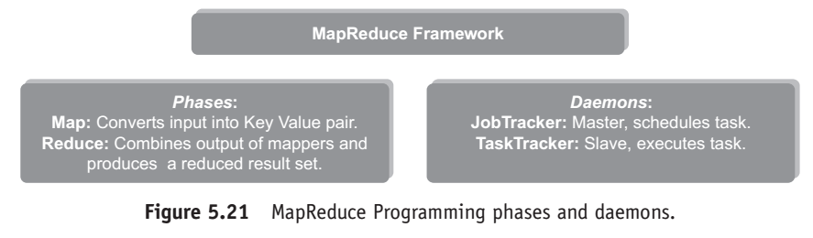

Slide 77
Special Features of HDFS
1. Data Replication:
There is absolutely no need for a client application to track all blocks. It redirects the client to the nearest replica to ensure high performance.

Slide 78
Data Pipeline
A client application writes a block to the first DataNode in the pipeline.
Then this DataNode takes over and forwards the data to the next node in the pipeline.

Slide 79
Processing Data withHadoop
MapReduce Programming is a software framework. MapReduce Programming helps you to process massive amounts of data in parallel. In MapReduce Programming, the input dataset is split into independent chunks.

Slide 80
Map tasks process these independent chunks completely in a parallel manner. The output produced by the map tasks serves as intermediate data and is stored on the local disk of that server. The output of the mappers are automatically shuffled and sorted by the framework. MapReduce Framework sorts the output based on keys.

Slide 81
This sorted output becomes the input to the reduce tasks. Reduce task provides reduced output by combining the output of the various mappers. Job inputs and outputs are stored in a file system. MapReduce framework also takes care of the other tasks such as scheduling, monitoring, re-executing failed tasks, etc.

Slide 82
Hadoop Distributed File System and MapReduce Framework run on the same set of nodes. This configuration allows effective scheduling of tasks on the nodes where data is present (Data Locality). This in turn results in very high throughput.

Slide 83
There are two daemons associated with MapReduce Programming.
A single master JobTracker per cluster and one slave TaskTracker per cluster-node.

Slide 84
The JobTracker is responsible for scheduling tasks to the TaskTrackers, monitoring the task, and re-executing the task just in case the TaskTracker fails.
The TaskTracker executes the task. Refer Figure 5.21.

Slide 85
The MapReduce functions and input/output locations are implemented via the MapReduce applications.
These applications use suitable interfaces to construct the job.

Slide 86
The application and the job parameters together are known as job configuration. Hadoop job client submits job jar/executable, etc.) to the JobTracker

Slide 87
Then it is the responsibility of Job Tracker to schedule tasks to the slaves.
In addition to scheduling, it also monitors the task and provides status information to the job-client.

Slide 88
Map Reduce Daemons
1.Job Tracker
2.Task Tracker

Slide 89
1. JobTracker:
It provides connectivity between Hadoop and your application.
When you submit code to cluster, Job Tracker creates the execution plan by deciding which task to assign to which node.
It also monitors all the running tasks.

Slide 90
When a task fails, it automatically re-schedules the task to a different node after a predefined number of retries.
JobTracker is a master daemon responsible for executing overall MapReduce job.
There is a single JobTracker per Hadoop cluster.

Slide 91
2. TaskTracker:
This daemon is responsible for executing individual tasks that is assigned by the JobTracker.
There is a single TaskTracker per slave and spawns multiple Java Virtual Machines (JVMs) to handle multiple map or reduce tasks in parallel.

Slide 92
TaskTracker continuously sends heartbeat message to JobTracker. When the JobTracker fails to receive a heartbeat from a TaskTracker, the JobTracker assumes that the TaskTracker has failed and resubmits the task to another available node in the cluster.

Slide 93
Once the client submits a job to the JobTracker, it partitions and assigns diverse MapReduce tasks for each TaskTracker in the cluster. Figure 5.22 depicts JobTracker and TaskTracker interaction.

Slide 94
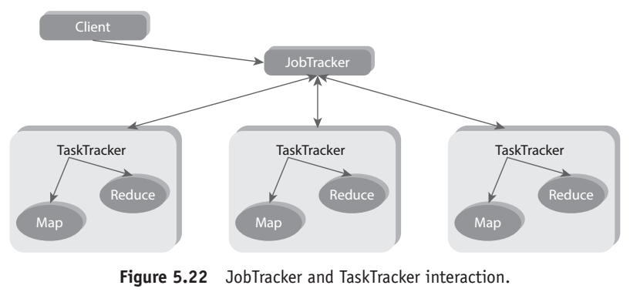
How does map reduce work?

Slide 95
How does MAP Reduce Work?
MapReduce divides a data analysis task into two parts − map and reduce.
Figure 5.23 depicts how the MapReduce Programming works.

Slide 96
In this example, there are two mappers and one reducer. Each mapper works on the partial dataset that is stored on that node and the reducer combines the output from the mappers to produce the reduced result set.

Slide 97
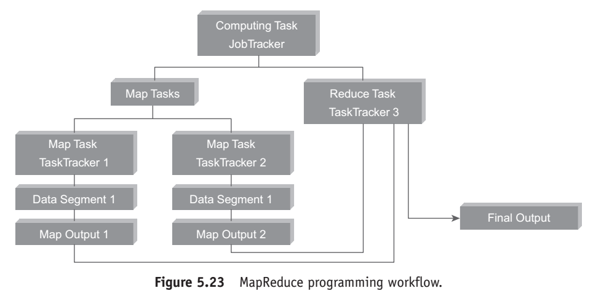

Slide 98
The following steps describe how MapReduce performs its task.
Figure 5.24 describes the working model of MapReduce Programming.
1. First, the input dataset is split into multiple pieces of data (several small subsets).

Slide 99
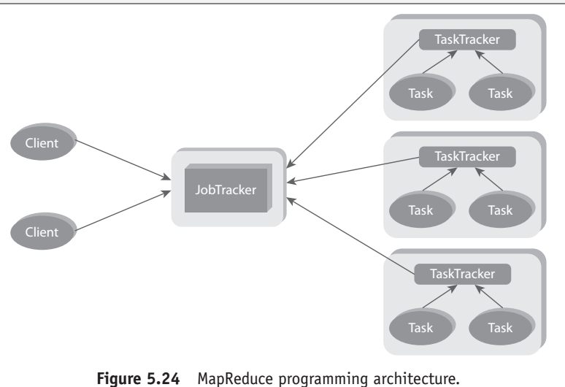

Slide 100
2. Next, the framework creates a master and several workers processes and executes the worker processes remotely.

Slide 101
3. Several map tasks work simultaneously and read pieces of data that were assigned to each map task.

Slide 102
The map worker uses the map function to extract only those data that are present on their server and generates key/value pair for the extracted data

Slide 103
4. Map worker uses partitioner function to dividethe data into regions.
Partitioner decides which reducer should get the output of the specified mapper

Slide 104
. 5. When the map workers complete their work, the master instructs the reduce workers to begin their work.

Slide 105
The reduce workers in turn contact the map workers to get the key/value data for their partition. The data thus received is shuffled and sorted as per keys.

Slide 106
6. Then it calls reduce function for every unique key. This function writes the output to the file.
7. When all the reduce workers complete their work, the master transfers the control to the user program.

Slide 107
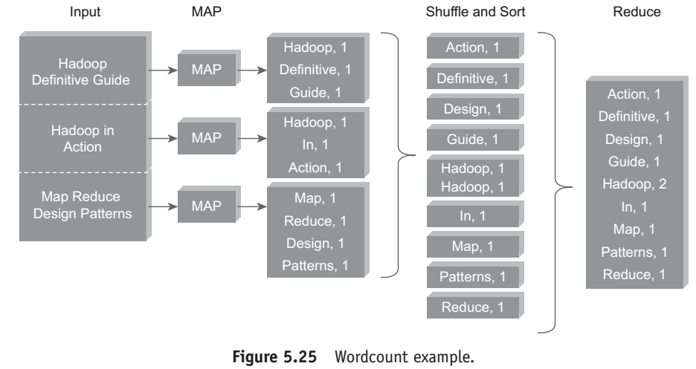

Slide 108
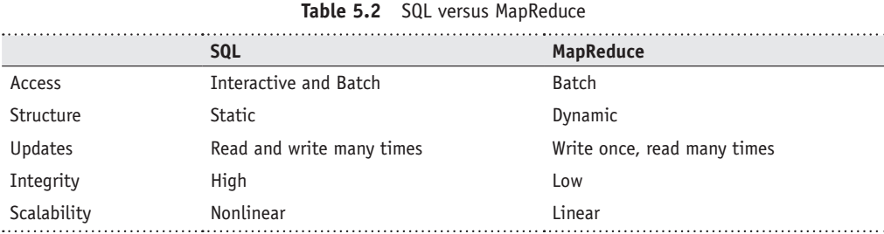
SQL Versus MapReduce

Slide 109
MANAGING RESOURCES AND APPLICATIONS WITH HADOOP YARN
YARN : (YET ANOTHER RESOURCE NEGOTIATOR)
Apache Hadoop YARN is a sub-project of Hadoop 2.x.
Hadoop 2.x is YARN-based architecture.
It is a general processing platform.
YARN is not constrained to MapReduce only.

Slide 110
You can run multiple applications in Hadoop 2.x in which all applications share a common resource management.
Now Hadoop can be used for various types of processing such as Batch, Interactive, Online, Streaming, Graph, and others.

Slide 111
Limitations of Hadoop 1.0 Architecture
1. Single NameNode is responsible for managing entire namespace for Hadoop Cluster.
2. It has a restricted processing model which is suitable for batch-oriented MapReduce jobs.

Slide 112
3. Hadoop MapReduce is not suitable for interactive analysis.
4. Hadoop 1.0 is not suitable for machine learning algorithms, graphs, and other memory intensive algorithms.

Slide 113
5. MapReduce is responsible for cluster resource management and data processing.
In this Architecture, map slots might be “full”, while the reduce slots are empty and vice versa.
This causes resource utilization issues. This needs to be improved for proper resource utilization.

Slide 114
HDFS Limitation
NameNode saves all its file metadata in main memory.
Although the main memory today is not as small and as expensive as it used to be two decades ago, still there is a limit on the number of objects that one can have in the memory on a single NameNode.

Slide 115
The NameNode can quickly become overwhelmed with load on the system increasing. In Hadoop 2.x, this is resolved with the help of HDFS Federation.

Slide 116
Hadoop 2: HDFS
HDFS 2 consists of two major components:
(a) namespace, (b) blocks storage service.
Namespace service takes care of file-related operations, such as creating files, modifying files, and directories. The block storage service handles data node cluster management, replication.

Slide 117
HDFS 2 Features
1. Horizontal scalability.
2. High availability.
HDFS Federation uses multiple independent NameNodes for horizontal scalability.
NameNodes are independent of each other. It means, NameNodes does not need any coordination with each other.

Slide 118
The DataNodes are common storage for blocks and shared by all NameNodes. All DataNodes in the cluster registers with each NameNode in the cluster.

Slide 119
The DataNodes are common storage for blocks and shared by all NameNodes.
All DataNodes in the cluster registers with each NameNode in the cluster.

Slide 120
High availability of NameNode is obtained with the help of Passive Standby NameNode.
In Hadoop 2.x, Active−Passive NameNode handles failover automatically.

Slide 121
All namespace edits are recorded to a shared NFS storage and there is a single writer at any point of time.
Passive NameNode reads edits from shared storage and keeps updated metadata information.

Slide 122
Hadoop 2 YARN: Taking Hadoop beyond Batch
YARN helps us to store all data in one place. We can interact in multiple ways to get predictable performance and quality of services.
This was originally architected by Yahoo. Refer Figure 5.28.

Slide 123
aIn case of Active NameNode failure, Passive NameNode becomes an Active NameNode automatically. Then it starts writing to the shared storage. Figure 5.26 describes the Active−Passive NameNode interaction.

Slide 124
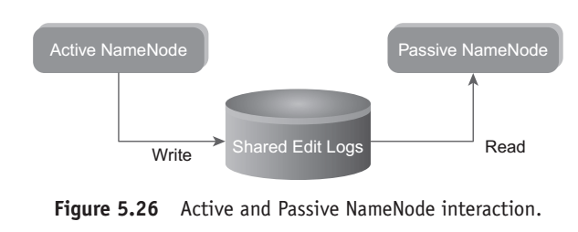

Slide 125
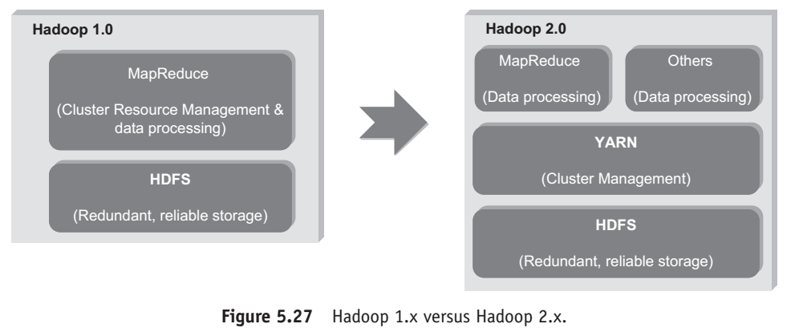

Slide 126
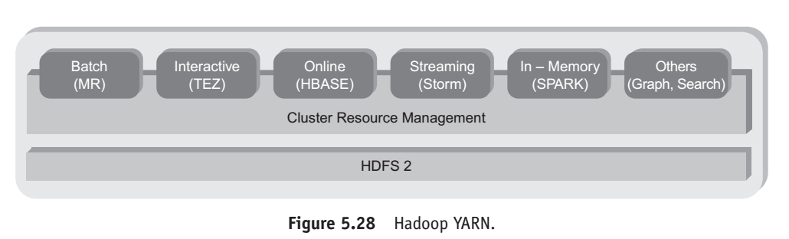

Slide 127
Fundamental Idea
The fundamental idea behind this architecture is splitting the JobTracker responsibility of resource management and Job Scheduling/Monitoring into separate daemons.

Slide 128
Daemons that are part of YARN Architecture
1. A Global ResourceManager:
Its main responsibility is to distribute resources among various applications in the system. application

Slide 129
It has two main components:
(a) Scheduler:
The pluggable scheduler of ResourceManager decides allocation of resources to various running applications.
The scheduler is just that, a pure scheduler, meaning it does NOT monitor or track the status of the application.

Slide 130
(b) ApplicationManager:
ApplicationManager does the following:
• Accepting job submissions.
• Negotiating resources (container) for executing the specific ApplicationMaster.
• Restarting the ApplicationMaster in case of failure.

Slide 131
2. NodeManager:
This is a per-machine slave daemon. NodeManager responsibility is launching the application containers for application execution.
NodeManager monitors the resource usage such as memory, CPU, disk, network, etc. It then reports the usage of resources to the global ResourceManager.

Slide 132
3. Per-application ApplicationMaster:
This is an application-specific entity. Its responsibility is to negotiaterequired resources forexecution from the ResourceManager.
It works along with the NodeManager for executing and monitoring component tasks.

Slide 133
Basic Concepts
Application:
1. Application is a job submitted to the framework. 2. Example – MapReduce Job.

Slide 134
Container:
1. Basic unit of allocation.
2. Fine-grained resource allocation across multiple resource types (Memory, CPU, disk, network, etc.)
(a) container_0 = 2GB, 1CPU
(b) container_1 = 1GB, 6 CPU
3. Replaces the fixed map/reduce slots.

Slide 135
YARN Architecture:
The steps involved in YARN architecture are as follows:
1. A client program submits the application which includes the necessary specifications to launch the application-specific ApplicationMaster itself.

Slide 136
2. The ResourceManager launches the ApplicationMaster by assigning some container.
3. The ApplicationMaster, on boot-up, registers with the ResourceManager.
This helps the client program to query the ResourceManager directly for the details.

Slide 137
4. During the normal course, ApplicationMaster negotiates appropriate resource containers via the resource-request protocol.

Slide 138
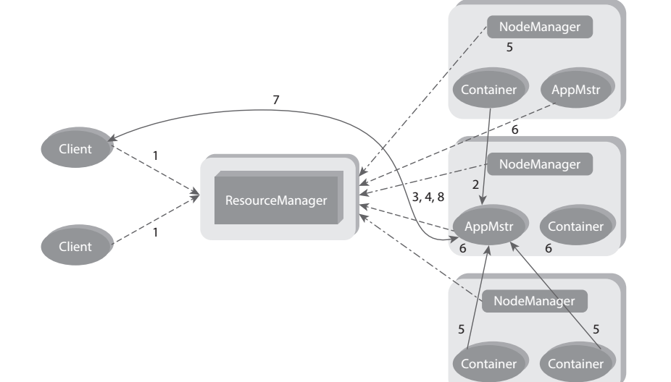
Yarn Architecture

Slide 139
5. On successful container allocations, the ApplicationMaster launches the container by providing the container launch specification to the NodeManager.

Slide 140
6. The NodeManager executes the application code and provides necessary information such as progress, status, etc. to it’s ApplicationMaster via an application-specific protocol

Slide 141
7. During the application execution, the client that submitted the job directly communicates with the ApplicationMaster to get status, progress updates, etc. via an application-specific protocol.

Slide 142
8. Once the application has been processed completely, ApplicationMaster deregisters with the ResourceManager and shuts down, allowing its own container to be repurposed.

Slide 143
INTERACTING WITH HADOOP ECOSYSTEM
1.Pig
2.Hive
3.Sqoop
4.Hbase
5.

Slide 144
Pig
Pig is a data flow system for Hadoop.
It uses Pig Latin to specify data flow.
Pig is an alternativeto MapReduce Programming.

Slide 145
It abstracts some details and allows you to focus on data processing.
It consists of two components.
1. Pig Latin: The data processing language. 2. Compiler: To translate Pig Latin to MapReduce Programming.

Slide 146
Hive
Hive is a Data Warehousing Layer on top of Hadoop.
Analysis and queries can be done using an SQL-like language.
Hive can be used to do ad-hoc queries, summarization, and data analysis.

Slide 147
Sqoop
Sqoop is a tool which helps to transfer data between Hadoop and Relational Databases.
With the help of Sqoop, you can import data from RDBMS to HDFS and vice-versa.

Slide 148
5.13.4 HBase
HBase is a NoSQL database for Hadoop.
HBase is column-oriented NoSQL database. HBase is used to store billions of rows and millions of columns.

Slide 149
HBase provides random read/write operation.
It also supports record level updates which is not possible using HDFS.
HBase sits on top of HDFS.

Slide 150
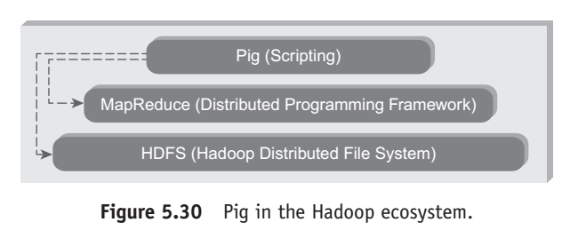

Slide 151
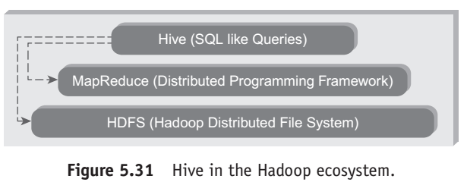

Slide 152
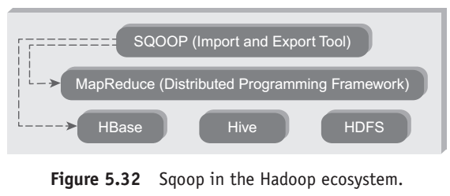

Slide 153
TEST ME A. Fill Me
1. Hadoop is ___________based flat structure.
2. RDBMS is best choice when___________ is the main concern.
3. Hadoop supports, _______,________and data formats.
4. RDBMS supports__________ data formats

Slide 154
5. In Hadoop, data is processed in. 6. HDFS can be deployed on. 7. NameNode uses to store file system namespace. 8. NameNode uses to record every transaction. 9. Secondary NameNode is a daemon. 10. DataNode is responsible for file operation.

